Slide 1

Title: Cloud Computing Fundamentals Subtitle: Curriculum Planning Name : Ravi Talakonda

Slide 2

Introduction
Purpose: To outline a curriculum designed to provide a thorough understanding of cloud computing fundamentals.
Agenda:
1.Curriculum Goal
2.Target Audience
3.Prerequisite Knowledge
4.Skill Level
5.Curriculum Objectives
6.Curriculum Outcomes
7.High-Level Course Structure
8.Learning Modality
9.Individual Course Outcomes
10.Suggested Practice and Assessment

Slide 3

Curriculum Goal
Goal: To provide learners with a comprehensive understanding of cloud computing fundamentals, enabling strategic decision-making and leveraging cloud technology for business transformation.
Rationale: Emphasizing the role of cloud technology in driving innovation, cost savings, and agility.

Slide 4

Target Audience
Learner Person:
Aspiring Cloud Professionals, IT Students, Entry-level IT Employees, Students with out cloud knowledge.
Profile Characteristics:
Strategic decision-makers
Focus on leveraging technology for business growth
Limited technical background but keen on understanding strategic implications
Influence on Curriculum Design:
Tailored to address business opportunities, challenges, and strategic use cases of cloud technology.

Slide 5

Prerequisite Knowledge
Prerequisites:
Basic understanding of IT infrastructure
Awareness of current business challenges and technology trends
Justification: Provides a foundation for grasping the cloud's value proposition and strategic impact.

Slide 6
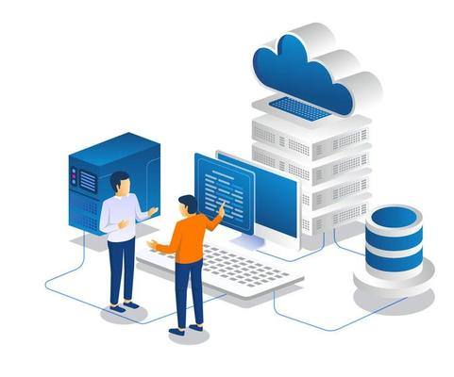
Skill Level
Skill Level:
Beginner to Intermediate
Explanation: Balancing technical insight with strategic application to facilitate informed decision-making on cloud strategies and investments.

Slide 7
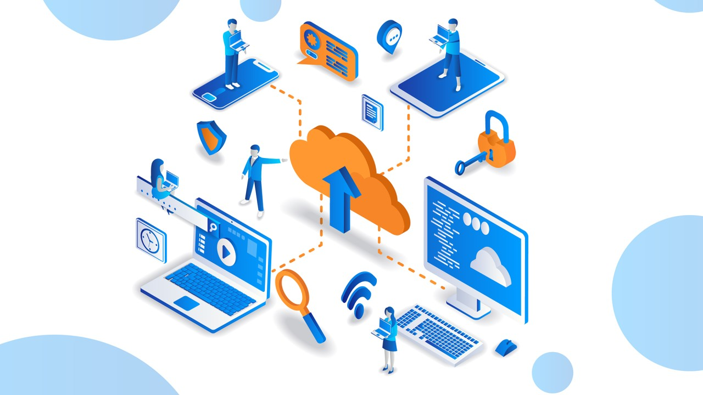
Curriculum Objectives:
Understand core cloud concepts and models (IaaS, PaaS, SaaS)
Learn about different deployment models (public, private, hybrid, multi-cloud)
Identify key cloud services and their business applications
Evaluate the strategic benefits and challenges of cloud adoption
Relevance: Ensures executives can make informed decisions and lead cloud-driven initiatives.

Slide 8

Curriculum Outcomes
Outcomes:
Enhanced ability to evaluate cloud solutions
Improved capability to drive cloud initiatives
Better understanding of cloud risks and benefits
Significance: Prepares executives to lead business transformation through cloud adoption.

Slide 9

High-Level Course Structure
Course Outline:
Introduction to Cloud Computing
Cloud Service Models (IaaS, PaaS, SaaS)
Deployment Models (public, private, hybrid, multi-cloud)
Basic Cloud Services and Use Cases
Strategic Implications of Cloud Adoption
Cloud Economics and Cost Management
Security and Compliance in the Cloud
Governance and Innovation Potential
Rationale: Structured to cover essential concepts and strategic insights, aligned with industry trends and evolving cloud landscape.

Slide 10

What is cloud?
Let’s assume that you are watching a cloud in the sky. But have you ever thought that you can watch the same cloud anywhere in your location. This is how it works , you can access the data/application via the internet at any time in anyway.

Slide 11



Why Cloud?
If you are working on Project for 30 days and you saved all your data and your local PC. But unexpectly your pc got broken. You lost all your Project data.
NOTE: Whenever you saved your data in a physical device like memory cards, CDs, and pen drives. If you lost these devices or if the devices gets crashed then the data should not be retrieved.

Slide 12
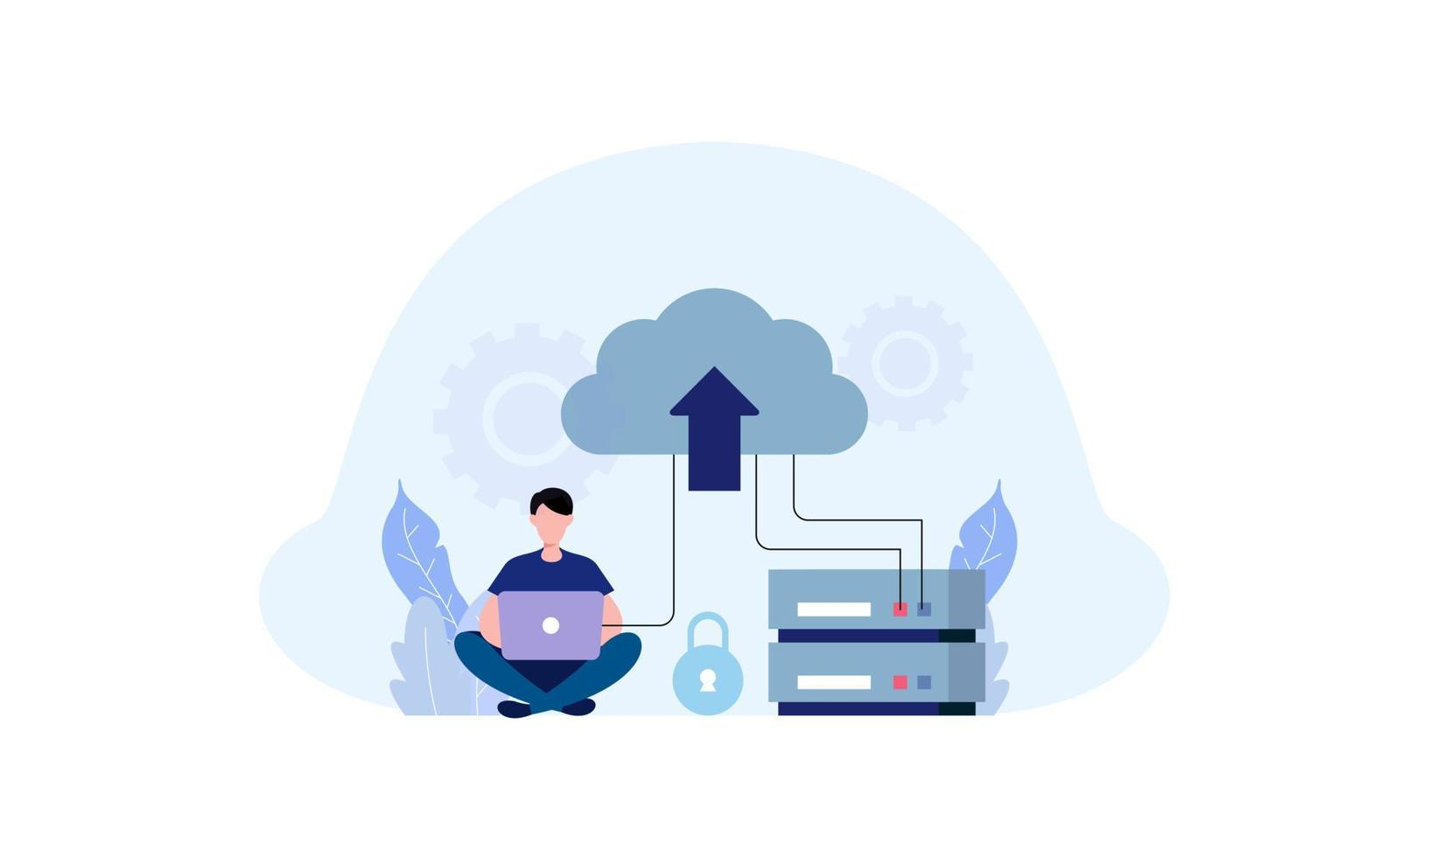

But what if you saved all your files into cloud
Now even if you lose your files now, no need to worry about data. Because all your files and folders are securely stored in the cloud .

Slide 13
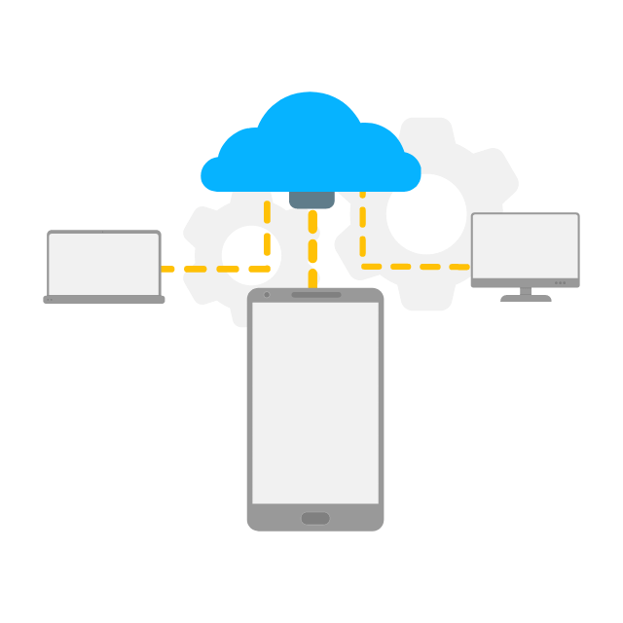
WHAT IS CLOUD COMPUTING?
Cloud Computing is the delivery of computing services like servers, storage, Database, Networking and software.
or
It is the processing of accessing the data or application via the internet.

Slide 14

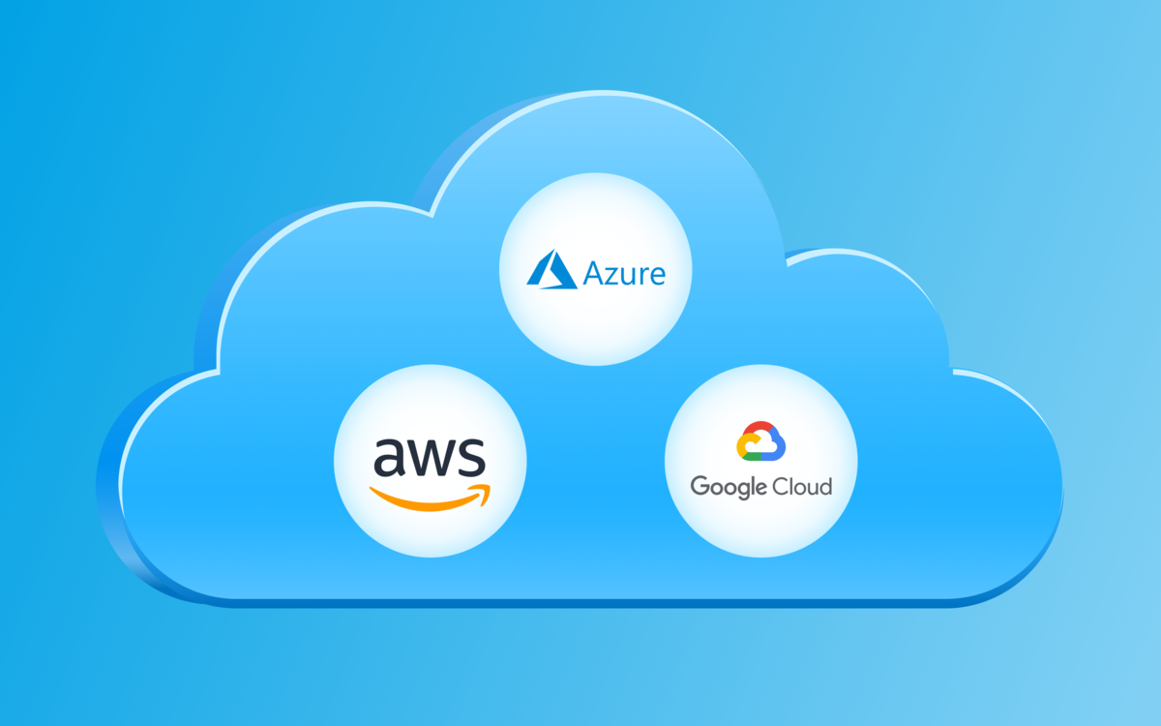
TYPES OF CLOUD COMPUTING?

Slide 15
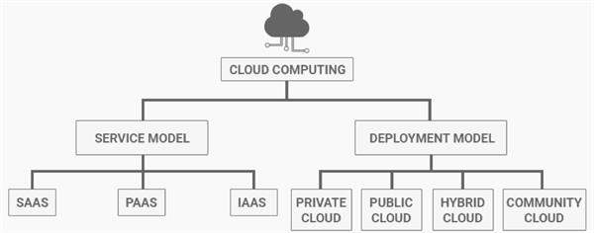

Slide 16
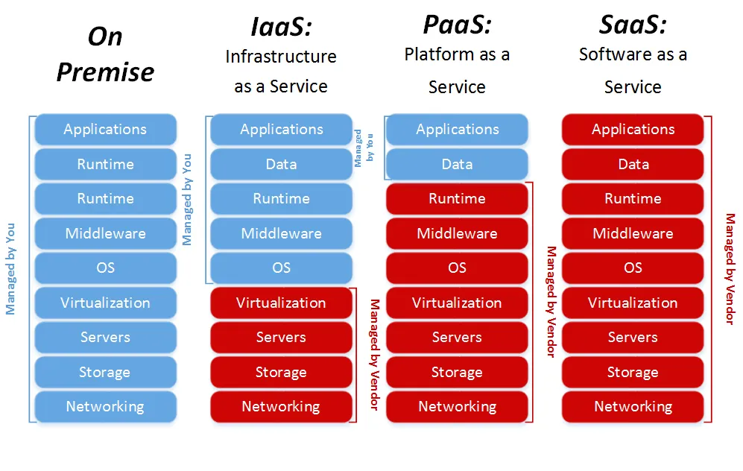
SERVICE MODEL:

Slide 17



Infrastructure as a Service(IaaS): In this model, the cloud provider offers virtualized computing resources. Such as virtual machines , storage and networking to customers.
Ex: AWS, AZURE, GCP used for Infrastructure provisioned and managed over internet.

Slide 18
Platform as a Service(PaaS): This model provides a platform for developers to develop run, and manage their own applications without having to worry about the underlying infrastructure.
Ex: Heroku, Google App Engine, Godaddy and Microsoft Azure App Service
Software as a Service(SaaS): SaaS is the most abstracted cloud computing type, delivering fully functional software applications via the internet. Users access the applications through a web browser. The provider hosts, maintains, and updates the software behalf of the user.
Ex: Gmail- you can manage inbox only, Google take care of data centers, servers, network, storage maintenance etc.. All you need worry about software and how you use it.

Slide 19
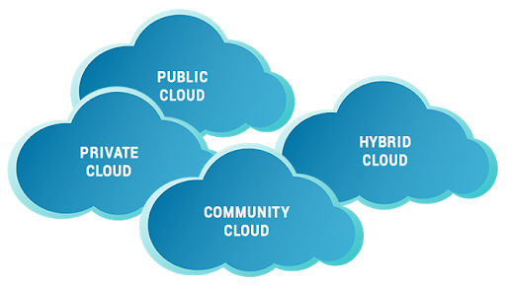
DEPLOYMENT MODEL:

Slide 20
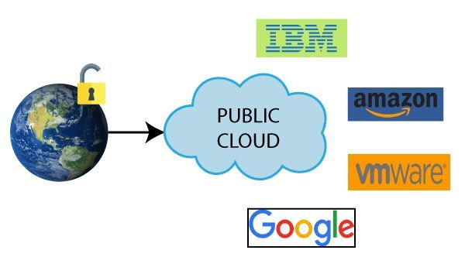
PUBLIC CLOUD:
Public cloud is open to all to store and access information via the internet.
Public clouds are managed by third parties. In public cloud, Security will be less when we compared to private and hybrid.

Slide 21
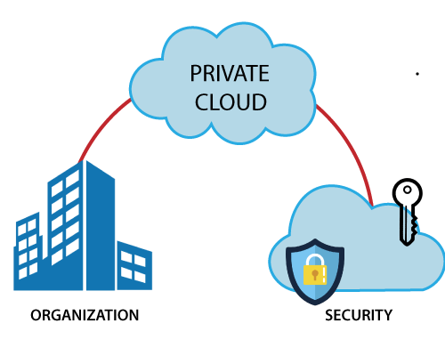
PRIVATE CLOUD:
A private cloud is also known as an internal cloud or corporate cloud. It is used by organizations to build and manage their data centres . In private cloud security will be high.

Slide 22
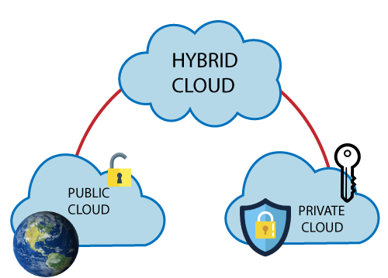
HYBRID CLOUD :
Hybrid cloud is the combination of both public and private cloud.
If the services are running on public then it will not have much security.
If the services are running on private then the cloud have high security.

Slide 23
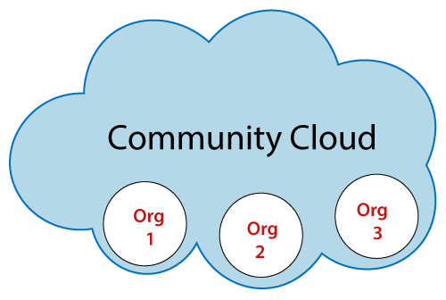
COMMUNITY CLOUD:
It allows multiple organizations to use same cloud to store their data.

Slide 24
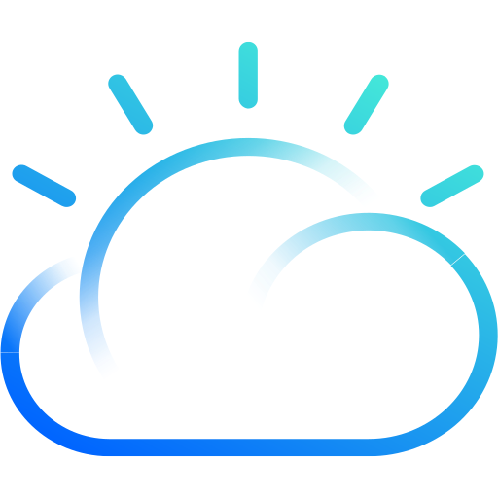




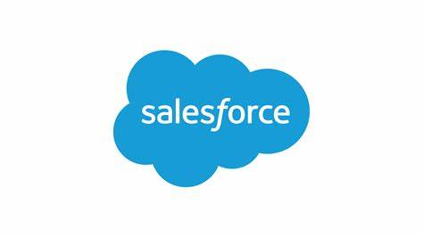



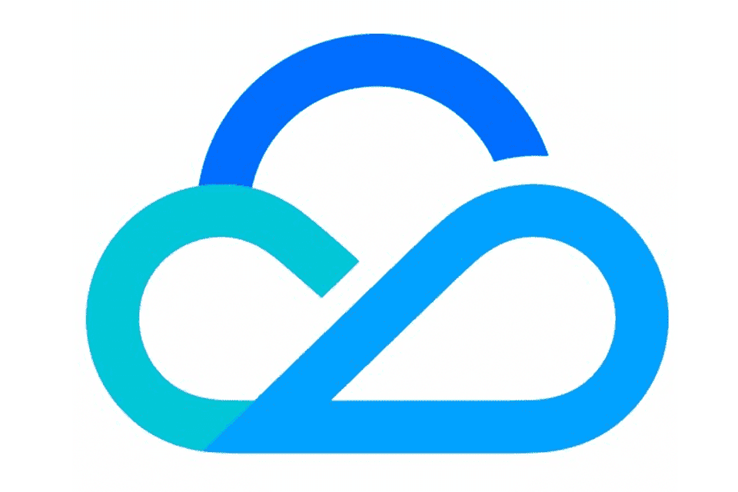
TOP 10 CLOUD PROVIDERS

Slide 25
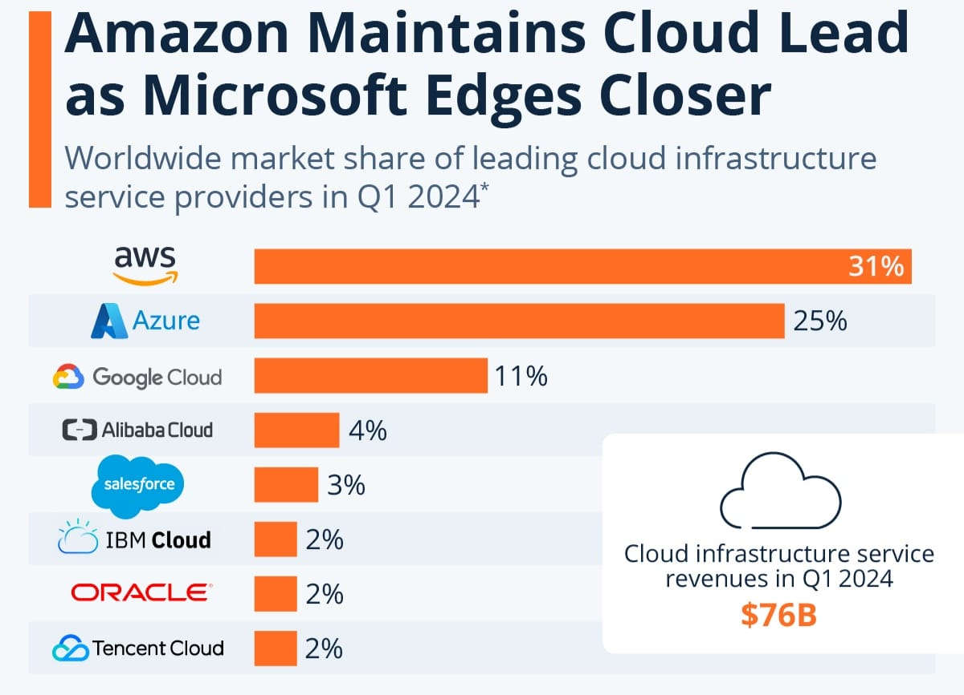

Slide 26

Cloud Economics
Cloud economics is the study of the costs, benefits, and economic principles of cloud computing for businesses.
Cloud economics analyzes the cost-benefit situation of building resources in the cloud, including:
Total cost of ownership
On-demand pricing
Return on investment

Slide 27

Cost Management
Cloud cost management is also known as cloud cost optimization or cloud cost governance .
Cloud cost management is the process of managing and reducing a business’s overall cloud spend.
Here are some key aspects of cloud cost management:
Resource Optimization
Cost Visibility and Analysis
Reserved Instances and Savings Plans
Budgeting and Alerts
Use of Serverless and Managed Services
Data Transfer Costs

Slide 28

Cloud Adoption
Cloud adoption brings about several strategic implications for businesses, affecting various aspects of their operations and competitive positioning.
Strategic implications of cloud adoption include:
Scalability and Flexibility
Cost Optimization
Global Reach and Accessibility
Innovation Acceleration
Improved Collaboration and Agility
Data Security and Compliance

Slide 29

Security and compliance
Security and compliance are critical considerations for businesses migrating to the cloud.
some key aspects of security and compliance in the cloud:
Data Encryption
Identity and Access Management (IAM)
Network Security
Security Monitoring and Incident Response
Data Backup and Recovery

Slide 30

Governance & Innovation Potential
Governance and innovation potential in the cloud are essential considerations for organizations looking to leverage cloud computing effectively.
Here's how they intersect and contribute to organizational success:
Governance Framework
Risk Management
Innovation Culture
Governance for Innovation
Continuous Improvement

Slide 31
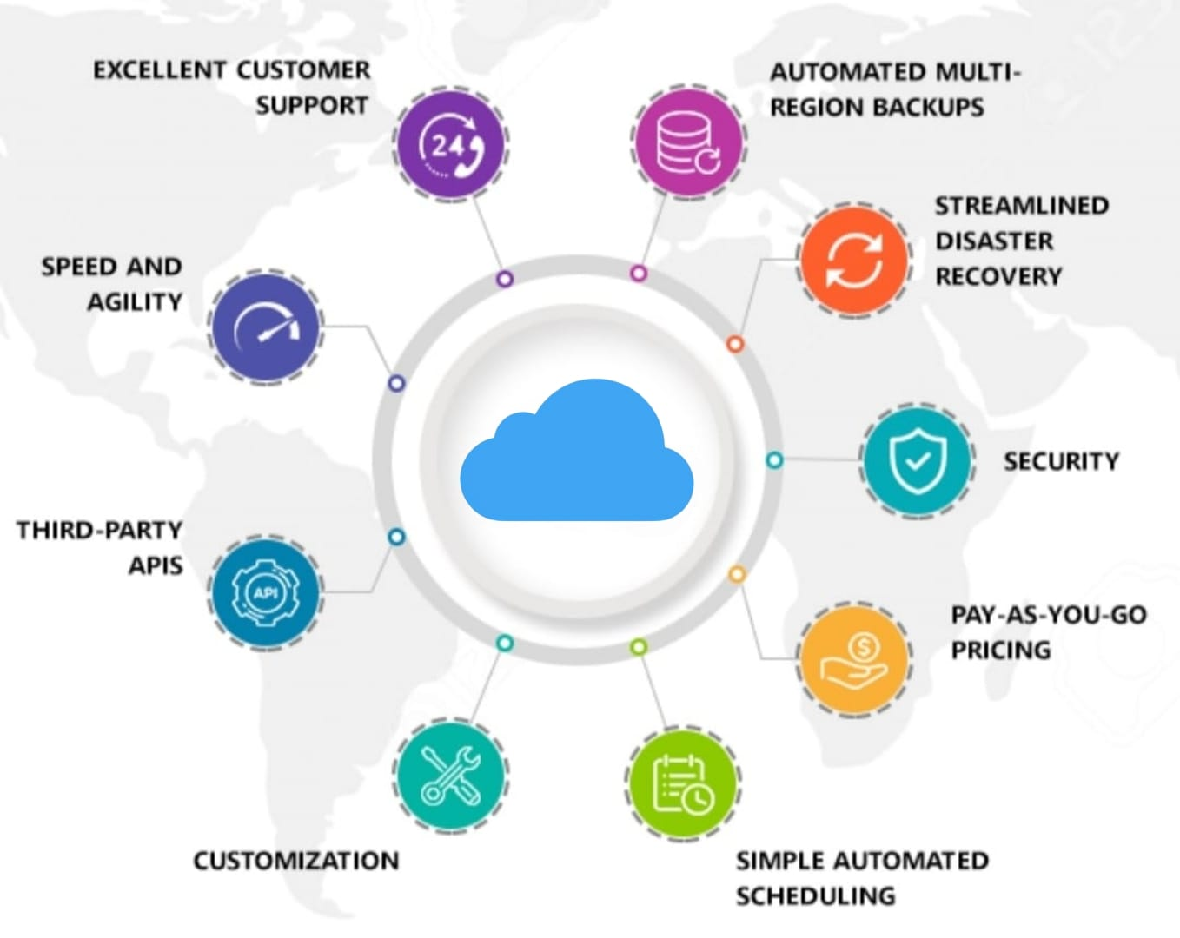
ADVANTAGES OF CLOUD COMPUTING

Slide 32

Disadvantages of Cloud Computing
cloud computing offers numerous advantages, it also comes with several disadvantages:
Security Concerns
Data Privacy and Compliance
Dependency on Internet Connectivity
Downtime and Reliability
Cost Management

Slide 33

Learning Modality
Delivery Methods:
Case Studies
Interactive Simulations
Expert-led Discussions
Rationale:
Effective for conveying both technical and strategic facets of cloud technology, ensuring comprehensive learning for executives.

Slide 34

Individual Course Outcome
Outcome:
Foundational understanding of cloud technology
Rationale:
Establishes a strong base for understanding cloud-based business strategies and making informed decisions.

Slide 35

Suggested Practice
Practical Activities:
Analysis of real-world Scenarios to understand practical applications.
Small Projects after each module to apply cloud concepts
Lab practices for hands-on experience with cloud services
Justification:
Relevant to real-world executive decision-making in the cloud domain.

Slide 36

Suggested Assessment Method
Assessment Methods:
Analysis of case studies
Strategic planning exercises
Reasoning:
Effectively measures the executive's grasp of cloud implications for their organization and strategic decision-making capabilities.

Slide 37
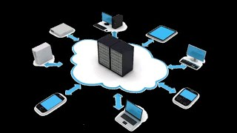
CONCLUSION
The rapid‎‎‎‎ evolution of cloud computing has‎‎‎‎ reshaped the way we store,‎‎‎‎ access, and manage data and‎‎‎ applications.

Slide 38

Questions and Support
if you have any questions or need clarification on the exercise, please reach out to me.

Slide 39


